Slide 1
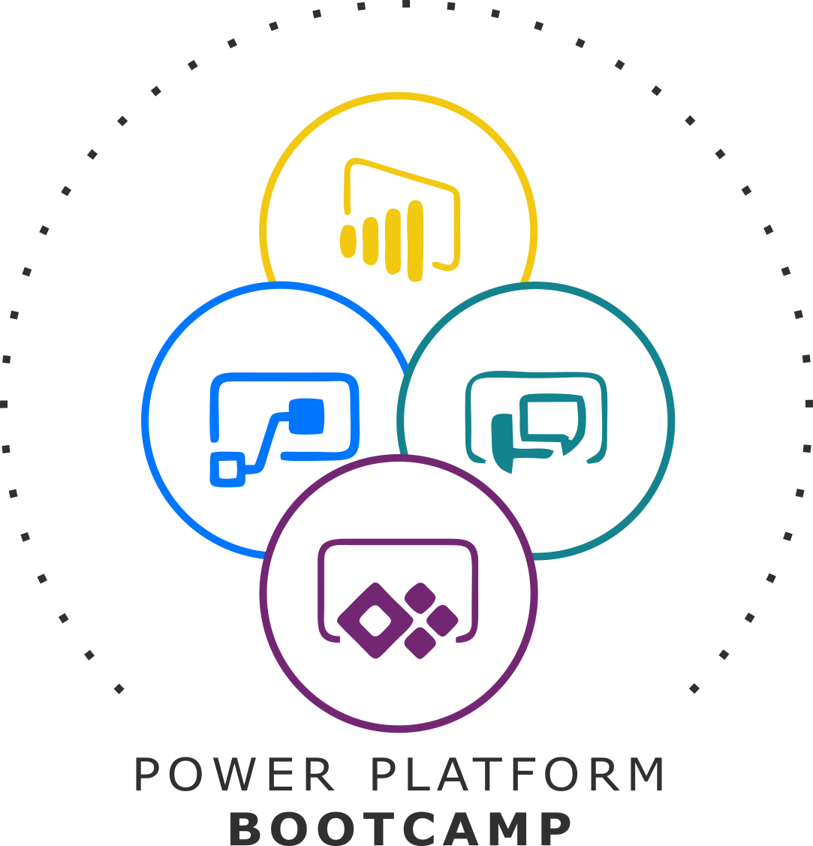
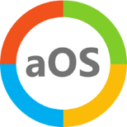


GLOBAL POWER PLATFORM BOOTCAMP
Organized Globally, Held Locally

Slide 2
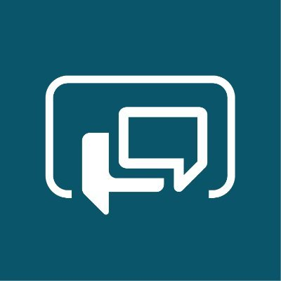
Build your First Chat Bot using Power Virtual Agents (PVA)
DHRUVIN SHAH

Slide 3

Dhruvin Shah
I’m working as Power Platform Specialist (P Factor – Power BI, Power Apps, Power Automate and Power Virtual Agents) and Sr. Office 365 Developer in one of the reputed company –“Binary Republik”.
Very Active Blogger and YouTuber having 100+ Articles and 230+ Tech Videos.
I’m Three(3) Times C# Corner MVP.

Slide 4
Build First Chatbot using Power Virtual Agents
Introduction to Power Virtual Agents
Introduction to Topics and Entities in Power Virtual Agents
Get Started with the Chat Bot Development Step by Step
Connect our Power Virtual Agents Chatbot with Power Automate
Deploy Chat Bot to Microsoft Teams
Deploy Chat Bot to Any Custom Web Site

Slide 5
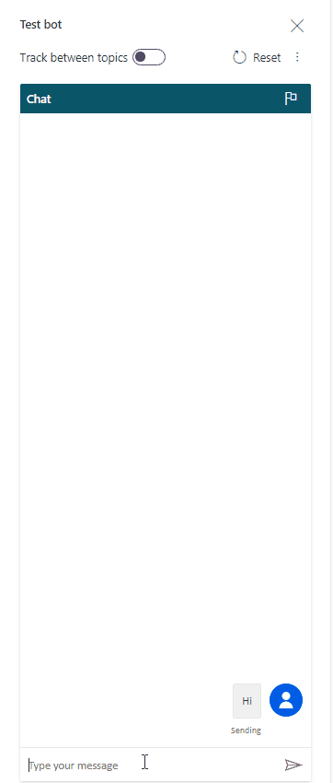
Session Agenda
We will build a Chat Bot for IT Help desk.
In any organization people face the problem related VM, Software, Configuration etc.
This Chat bot will auto assign ticket to IT admin.
At last, we will deploy this chat bot to MS Teams and any third party website.

Slide 6
Introduction to Power Virtual Agents

Slide 7
What is Power Virtual Agents?
PVA (Power Virtual Agent) empowers us to quickly create Powerful chatbots for our businesses or organization without any help of developers and data scientists.
It offers us powerful UI, using which one can easily create chatbot without any knowledge of any coding background. It’s a game changer in the world of Power Platform.
Also, I love the slogan mentioned in the official site – “Powerful alone. Better together”. This is true. Its connectivity with Office 365 components like Power Apps, Power BI, Power Automate, makes the business process smoother.

Slide 8
Let’s Open PVA Home Page and Explore different Components

Slide 9
Introduction to Topics

Slide 10
Topics in PVA
In a simple word we can say that Topic defines how a bot will play their conversation.
Existing Topics
User Topics
System Topics
Suggested Topics

Slide 11
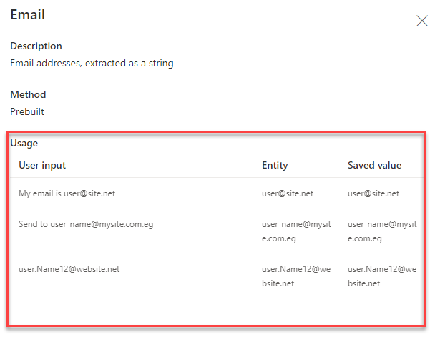
Entities in PVA
The main advantage of Power Virtual Agent is it understands natural language. Sometimes we need to pick the value from the user input and need to save in our database.
PVA supports so many OOTB entities. With that we can create our custom entity as well.
Let’s say If Bot asks a question like, “please enter your email address.”

Slide 12
Build your first Chat Bot Step by Step

Slide 13
IT Chat Bot Example:

Slide 14
Let’s Build a Chat Bot

Slide 15
Connect your Bot to Power Automate

Slide 16
Let’s Connect Power Automate with PVA

Slide 17
Deploy Chat Bot to MS Teams

Slide 18
Deployment Procedure:

Slide 19
Deploy Chat Bot to Any Web Site

Slide 20
Deployment Procedure:

Slide 21
Any Questions?

Slide 22






Get In Touch
+91 9537981467
@DhruvinShah16
https://www.facebook.com/learn2All/
https://www.youtube.com/user/dhruvin953798
https://tinyurl.com/uak32tg
https://tinyurl.com/w94pcxs

Slide 23
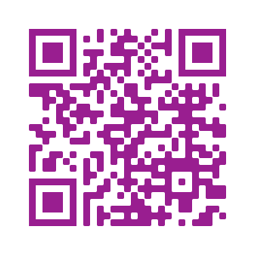
Please fill out the survey! & Win Swags!!
https://www.powerplatformbootcamp.com/survey

Slide 24
Thank You For Attending

